Slide 1

Campaign
proposal
Java for hipsters
Report after attending of JEEEconf 2016
Hack‘n’Tell

Slide 2

What hipster likes:
- Trendy stuff
- TV series from Netfix
- Dislike to work hard
Campaign
proposal

Slide 3
Agenda
Hack‘n’Tell
- code generation
- microservices & tools
- how can be improved

Slide 4

Project & code generation:
Create each time folder structure with the same web.xml, myapp-servlet.xml, MyAppApplication.class, etc IS TOO BORING!
Lets kickstart project with generator!
Campaign
proposal

Slide 5

Jhipster:
Campaign
proposal

Slide 6

Notes:
<number>

Slide 7
Texts
Hack‘n’Tell
Text for head 35 px
Text block 18 px
Looking to develop a 2D / 3D game to play equally brilliant in mobile browsers as well as on iOS, Android, Wii, Xbox 360, Playstation 3, Flash, Linux, Windows and Mac OS? With the Unity game building engine you don’t have to set up many game development teams – you build once and deploy to
Text block 14px
Looking to develop a 2D / 3D game to play equally brilliant in mobile browsers as well as on iOS, Android, Wii, Xbox 360, Playstation 3, Flash, Linux, Windows and Mac OS?
With the Unity game building engine you don’t have to set up many game development teams – you build once and deploy to over 17 gaming platforms!
Intersog offers you to leverage our extensive Unity development expertise
Text Open Sanse 18px
Text Open Sans 14px
Text Open Sans 12px
Notes:
Comments about it
<number>

Slide 8
Txt. Tables
Hack‘n’Tell
Text Open Sans 18px | Text Open Sans 18px | Text Open Sans 18px
Text about this row | 12 | 234
Text about this row | 34 | 234
Text about this row | 34 | 234
Text about this row | 234 | 234
Text about this row | 54 | 234
Text about this row | 654 | 24
Text about this row | 345 | 245
Text about this row | 24 | 4532
Text about this row | 234 | 4345

Slide 9
Promo title text in the center
Subtitle text about promo text

Slide 10

Promo title text in the center
Subtitle text about promo text
Notes:
Slides, illustrated with photos, the best form of one large photos and text than several small and Text
<number>

Slide 11

Title text 35px
Looking to develop a 2D / 3D game to play equally brilliant in mobile browsers as well as on iOS, Android, Wii, Xbox 360, Playstation 3, Flash, Linux, Windows and Mac OS?
With the Unity game building engine you don’t have to set up many game development teams – you build once and deploy to over 17 gaming platforms!
Open Sans Semibold 16px
First Text title;
Second text title;
Third text title;
Fourth text title;
Notes:
Photographs illustrating the text, drawn up in a circular mask and displayed without strokes, shadows and other effects
<number>

Slide 12

Txt. Version of the layout
Hack‘n’Tell
Text block 14px
Looking to develop a 2D / 3D game to play equally brilliant in mobile browsers as well as on iOS, Android, Wii, Xbox 360, Playstation 3, Flash, Linux, Windows and Mac OS?
With the Unity game building engine you don’t have to set up many game development teams – you build once and deploy to over 17 gaming platforms!
Intersog offers you to leverage our extensive Unity development expertise
Notes:
<number>

Slide 13

Txt. Version of the layout
Hack‘n’Tell
Looking to develop a 2D / 3D game to play equally brilliant in mobile browsers as well as on iOS, Android, Wii, Xbox 360, Playstation 3, Flash, Linux, Windows and Mac OS?
With the Unity game building engine you don’t have to set up many game development teams – you build once and deploy to over 17 gaming platforms!
Looking to develop a 2D / 3D game to play equally brilliant in mobile browsers as well as on iOS, Android, Wii, Xbox 360, Playstation 3, Flash, Linux, Windows and Mac OS?
With the Unity game building engine you don’t have to set up many game development teams – you build once and deploy to over 17 gaming platforms!
Notes:
<number>

Slide 14

Txt. Version of the layout
Hack‘n’Tell
Background
Founded in October 1997, PhatWare Corporation is a leading provider of easy to use powerful software products and professional services for the mobile and desktop computing marketplace. PhatWare specializes in handwriting recognition, digital ink, note taking and database, and network management software development. PhatWare's products include such popular titles as PenOffice(R), PhatPad(R), WritePad(R), and others. PhatWare Corporation is a Microsoft Certified Partner, and Intel Software Partner.
Notes:
<number>

Slide 15
Founded in October 1997, PhatWare Corporation is a leading provider of easy to use powerful software products and professional services for the mobile and desktop computing marketplace. Phat Ware specializes in handwriting recognition, digital ink, note taking and database, and network management software development. PhatWare's products include such popular titles as PenOffice(R), PhatPad(R), WritePad(R), and others. PhatWare Corporation is a Microsoft Certified Partner.
Competitive overview
founded
Notes:
<number>

Slide 16

Optimization
& Social Media
Founded in October 1997, PhatWare Corporation is a leading provider of easy to use powerful software products and other project
Notes:
<number>

Slide 17
Optimization
& Social Media
Founded in October 1997, PhatWare Corporation is a leading provider of easy to use powerful software products and other project
Notes:
<number>

Slide 18


Txt. Version of the layout
Hack‘n’Tell
Text block 14px
Looking to develop a 2D / 3D game to play equally brilliant in mobile browsers as well as on iOS, Android, Wii, Xbox 360, Playstation 3, Flash, Linux, Windows and Mac OS?
With the Unity game building engine you don’t have to set up many game development teams – you build once and deploy to over 17 gaming platforms!
Intersog offers you to leverage our extensive Unity development expertise
Mobile Marketing Agency
Notes:
<number>

Slide 19
Promo title text in the left 35px
Looking to develop a 2D / 3D game to play equally brilliant in mobile browsers as well as on iOS, Android, Wii, Xbox 360, Playstation 3, Flash, Linux, Windows and Mac
Looking to develop a 2D / 3D game to play equally brilliant in mobile browsers as well as on iOS, Android, Wii, Xbox 360, Playstation 3, Flash, Linux, Windows and Mac
Looking to develop a 2D / 3D game to play equally brilliant in mobile browsers as well as on iOS, Android, Wii, Xbox 360, Playstation 3, Flash, Linux, Windows and Mac
Notes:
<number>

Slide 20

Txt. Tables
Hack‘n’Tell
Looking to develop a 2D / 3D game to play equally brilliant in mobile browsers as well as on iOS, Android, Wii, Xbox 360, Playstation 3, Flash, Linux, Windows and Mac
Looking to develop a 2D / 3D game to play equally brilliant in mobile browsers as well as on iOS, Android, Wii, Xbox 360, Playstation 3, Flash, Linux, Windows and Mac
Looking to develop a 2D / 3D game to play equally brilliant in mobile browsers as well as on iOS, Android, Wii, Xbox 360, Playstation 3, Flash, Linux, Windows and Mac
Notes:
<number>

Slide 21
Graphs and Charts
Hack‘n’Tell
Text block 14px
Looking to develop a 2D / 3D game to play equally brilliant in mobile browsers as well as on iOS, Android, Wii, Xbox 360, Playstation 3, Flash, Linux, Windows and Mac OS?
With the Unity game building engine you don’t have to set up many game development teams – you build once and deploy to over 17 gaming platforms!
Intersog offers you to leverage our extensive Unity development expertise
Notes:
<number>

Slide 22
Graphs and Charts
Hack‘n’Tell
Text block 14px
Looking to develop a 2D / 3D game to play equally brilliant in mobile browsers as well as on iOS, Android, Wii, Xbox 360, Playstation 3, Flash, Linux, Windows and Mac OS?
With the Unity game building engine you don’t have to set up many game development teams – you build once and deploy to over 17 gaming platforms!
Intersog offers you to leverage our extensive Unity development expertise
Notes:
<number>

Slide 23



Images
Hack‘n’Tell
Notes:
<number>

Slide 24



Images
Hack‘n’Tell
Text block name
Looking to develop a 2D / 3D game to play equally brilliant in mobile browsers as well as on iOS, Android, Wii, Xbox 360,
Text block name
Looking to develop a 2D / 3D game to play equally brilliant in mobile browsers as well as on iOS, Android, Wii, Xbox 360,
Text block name
Looking to develop a 2D / 3D game to play equally brilliant in mobile browsers as well as on iOS, Android, Wii, Xbox 360,
Notes:
<number>

Slide 25





Images
Hack‘n’Tell
Notes:
<number>

Slide 26
THANK YOU
intersog@Intersog.com
Notes:
<number>

Slide 27



Templates
Founded in October 1997, PhatWare Corporation is a leading provider of easy to use powerful software products and professional services for the mobile and desktop computing marketplace. PhatWare specializes in handwriting recognition, digital ink, note taking and database, and network management software development. PhatWare's products include such popular titles as PenOffice(R), PhatPad(R), WritePad(R), and others. PhatWare Corporation is a Microsoft Certified Partner, and Intel Software Partner. social media promotion throughout both European and US markets. PhatWare's products include such popular comprehensive marketing.
Challenge
In need of a comprehensive marketing solution on behalf of their app PhatPad, PhatWare Corp. sought to promote both the iOS & Android versions of their product. Specifically, the company was in need of media coverage and social media promotion throughout both European and US markets. PhatWare's products include
Notes:
<number>

Slide 28


Our favorite
Beach
In need of a comprehensive marketing solution on behalf of their app PhatPad, PhatWare Corp. sought to promote both the iOS & Android versions of their product. Specifically, the company was in need of media coverage and social media promotion throughout both European and US markets.
Notes:
<number>

Slide 29



New collection
Spring-Summer
2014
Looking to develop a 2D / 3D game to play equally brilliant in mobile browsers as well as on iOS, Android, Wii, Xbox 360, Playstation 3, Flash, Linux, Windows and Mac OS? With the Unity game building engine you don’t have to set up many game development teams – you build once and deploy to over 17 gaming platforms!
Notes:
<number>

Slide 30

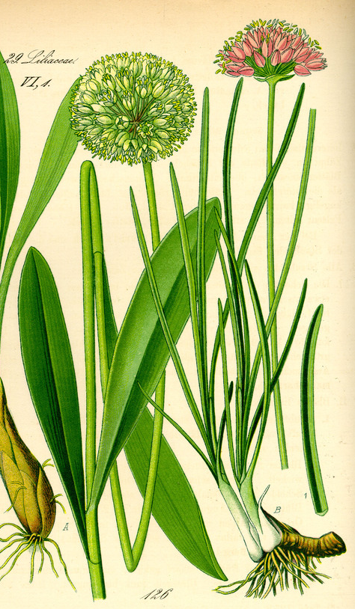
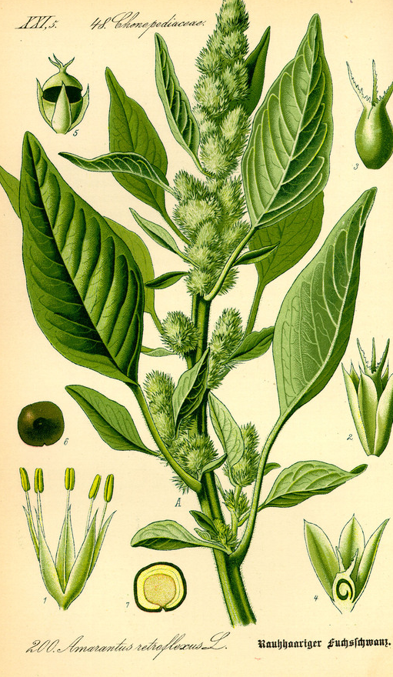
Allium victorialis
Allium victorialis, commonly known as victory onion, Alpine leek, or caucas, is a broad-leaved species of that occurs widely in mountainous or northerly regions across Europe and Asia.
Notes:
<number>

Slide 31

Our home in the village
I like my home. Corporate design for a construction company. The business cards symbolise bricks; by sticking them together in different ways they create the impression of a building.
Notes:
<number>

Slide 32

My summer
Holidays
In Croatia
Notes:
<number>

Slide 33
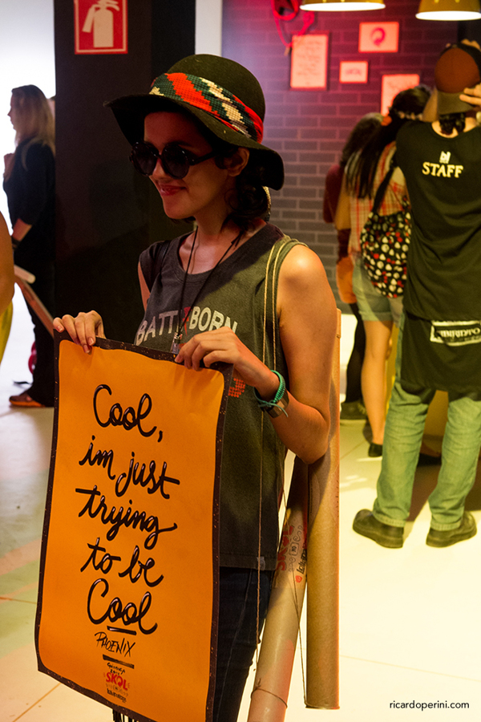
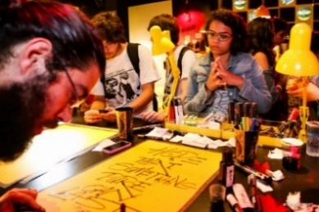

Lollapalooza —Music on Paper
I was invited by Jackson Alves and Criatipos to be a part of the team that made "Music on Paper" where you could ask for your favorit lyrics to be made into a poster, live during the two days of Lollapalooza São Paulo
Notes:
<number>

Slide 34






My Birthday
2015
Notes:
<number>

Slide 35

People, television
and radio
Notes:
<number>

Slide 36

The man and his
secretary
Notes:
<number>

Slide 37

Presentation
About Fonts
Founded in October 1997, PhatWare Corporation is a leading provider of easy to use powerful software products and
Notes:
<number>

